Slide 1
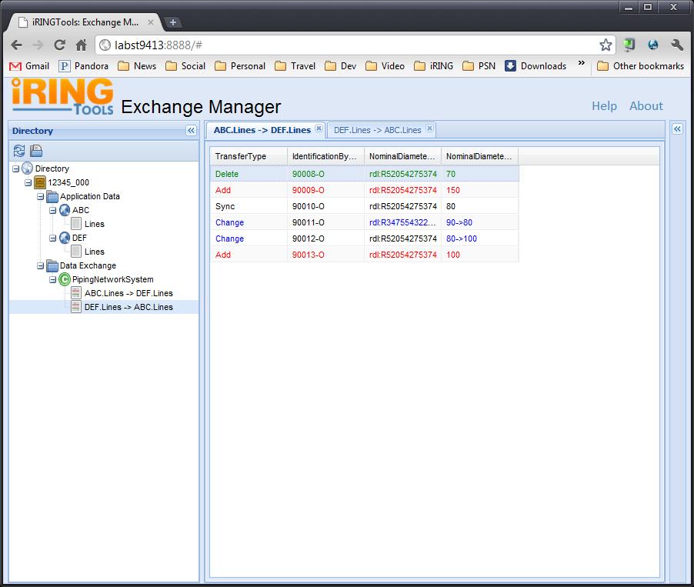
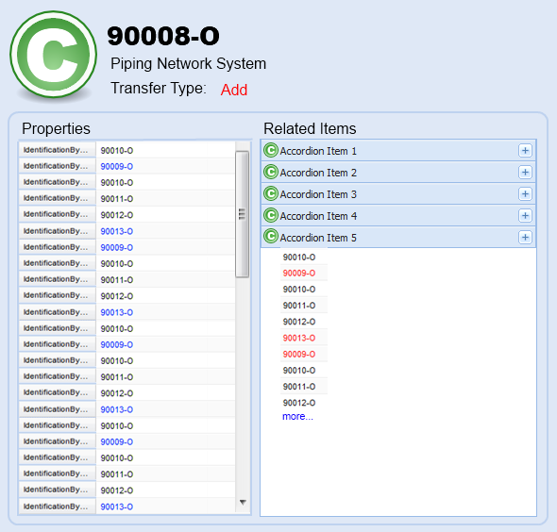
IRINGTOOLS-18: Related Item Navigation: Individual Info
Notes:
Original Estimate: 2d
Sub Tasks:
Package ExchangeManager for Deployment.
Deploy ExchangeManager Package and Verify on Test Server.
Help Link will goto: http://iringug.org/wiki/index.php?title=ESBUsersGuide

Slide 2
IRINGTOOLS-18: Related Item Navigation: Breadcrumbs
Lines
90008-O
Related Class
RelClass-1
Notes:
Original Estimate: 2d
Sub Tasks:
Package ExchangeManager for Deployment.
Deploy ExchangeManager Package and Verify on Test Server.
Help Link will goto: http://iringug.org/wiki/index.php?title=ESBUsersGuide

